Slide 1
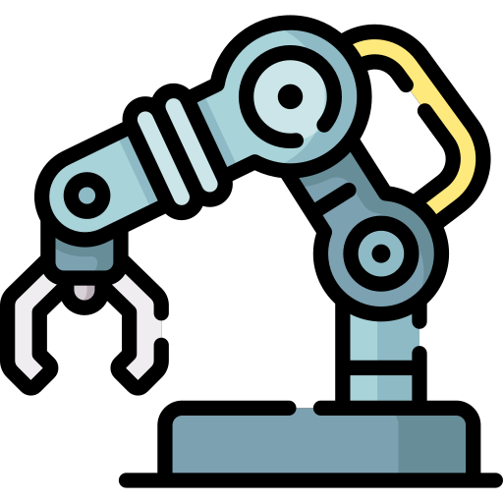
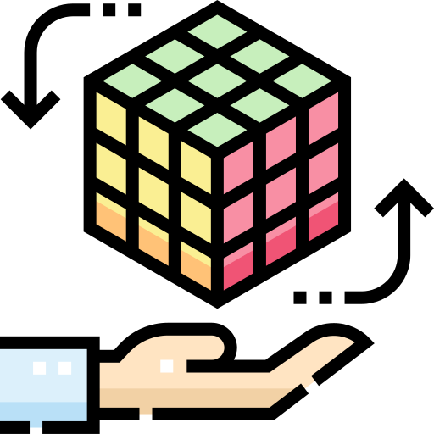
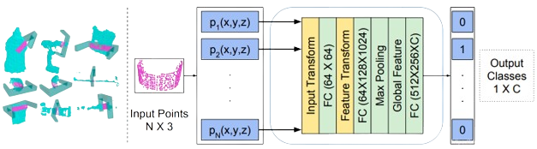
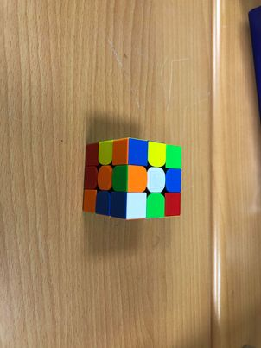
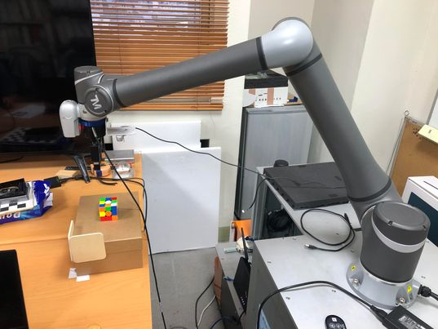
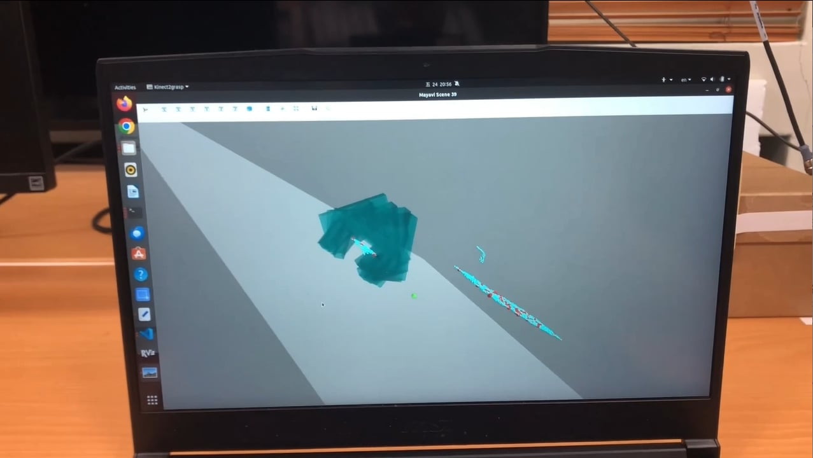
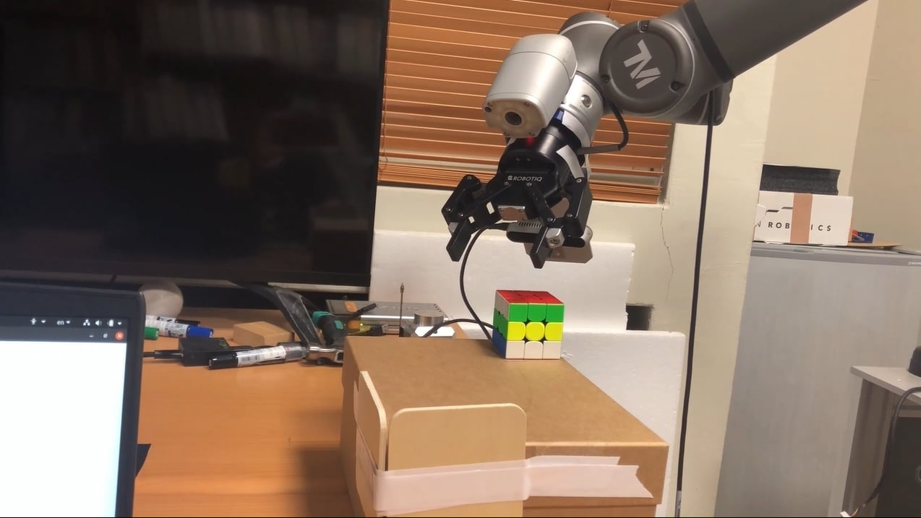
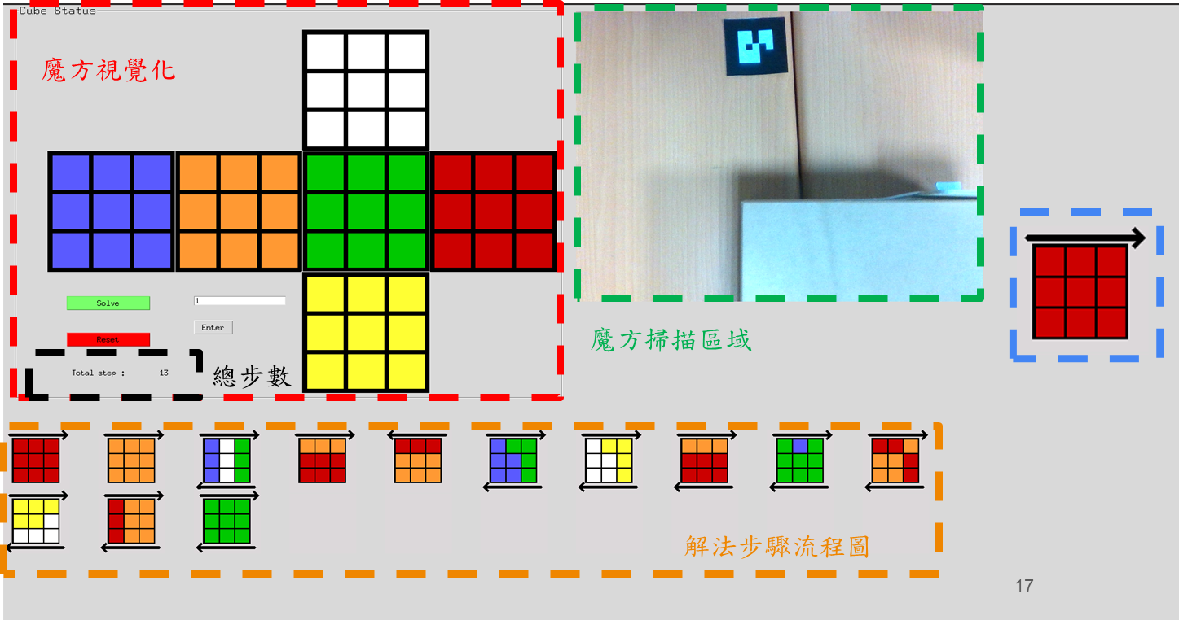
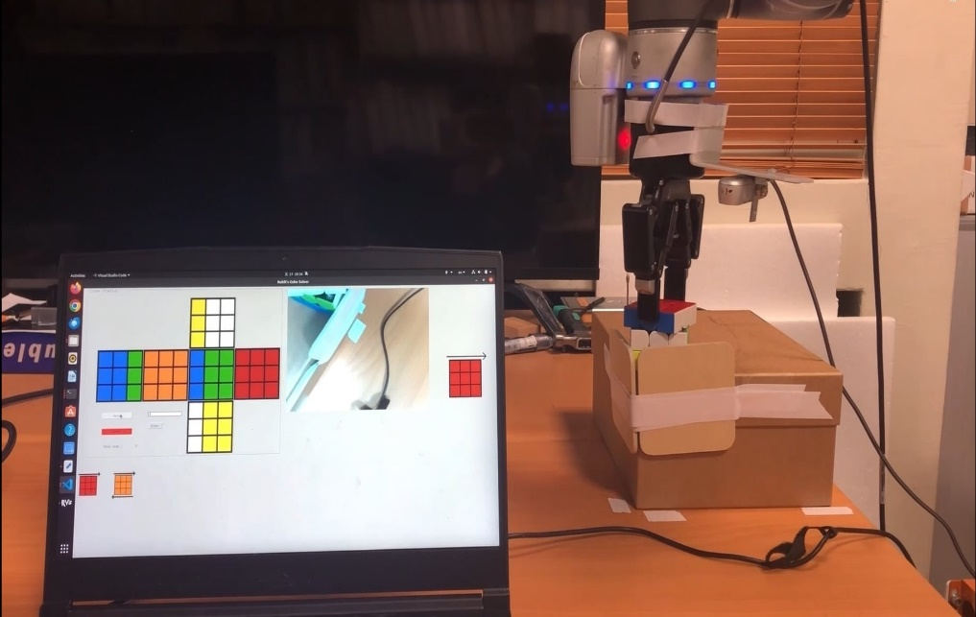
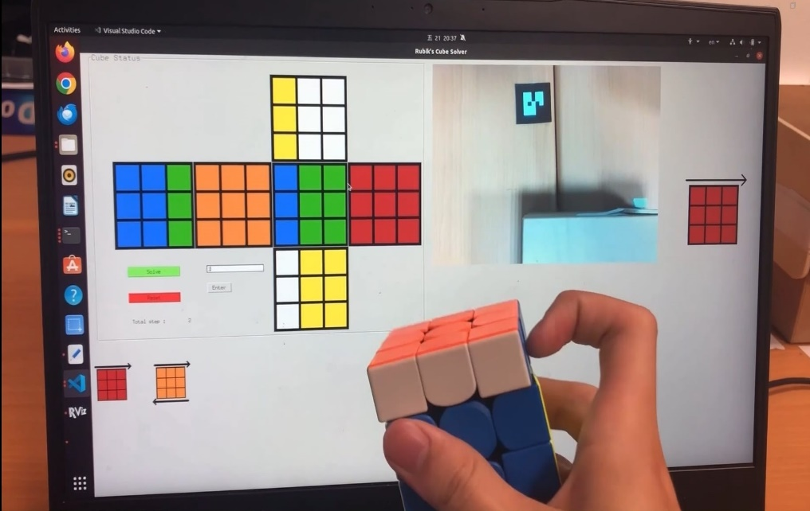
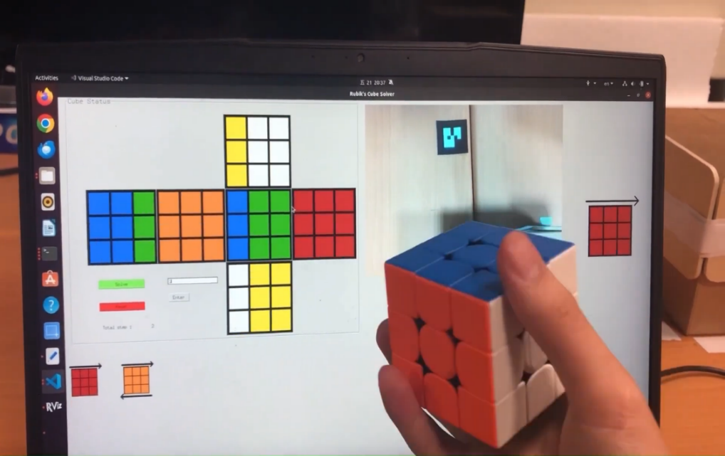
A Rubik's Cube Solution Using Deep Learning and Robotic Arm Coordination
Group 5-11
Advisor: JENN-JIER JAMES LIEN
Members: HSING-YU LIN, YEN-SHUN LEE
Motivation
User Interface
In recent years, the rapid development of human-robot collaboration has enabled us to leverage robotic arms for more human-centric applications. Therefore, we aim to utilize robotic arms, image recognition systems, and Rubik's Cube algorithms to guide humans in solving the Rubik's Cube.
Model
The PointNetGPD framework is designed to detect reliable grasp configurations from point cloud data.
Utilizing raw sensor input from a standard RGB-D camera, the system first converts the depth map into a point cloud.
Several grasp candidates are then sampled, incorporating essential geometric information as heuristics or constraints.
For each candidate, the point cloud within the gripper's vicinity is cropped and transformed into local coordinates.
This localized point cloud data is subsequently fed into a grasp quality evaluation network.
The grasp candidate with the highest evaluation score is selected for execution.
System Framework
1
Receive image from sensor
2
Grasp prediction
3
Scan and solving
PointNetGPD model
Get the coordinate of the grasp pose
1) Scan the Rubik's Cube
2) Make solution through Herbert Kociemba’s two-phase algorithm
(if the pattern is wrong, make new solution)
3) User enters rotation number
4) Rotate rubik's cube
5
The user manipulates the Rubik's Cube as desired and then returns it to the robotic arm for the next iteration if the Rubik's Cube is not solved, or concludes the process if the Rubik's Cube is solved
4
Humanity's Turn
1.Robot moves the rubik’s cube to the specified position
2. Robot return to home state and continue to detect rubik’s cube
1
Results
Result
1.
1.Receive image from sensor & Grasp prediction
2. Scan the Rubik's Cube
3. Make solution of the Rubik's Cube
4. The robot arm is manipulating a Rubik's Cube
5. The person is manipulating a Rubik's Cube
6. The Rubik's Cube is solved

